Slide 1

Disease Prediction Model
Heart disease
Done by: Rahma Semma & Nishtha Sharma

Slide 2
Introduction
Why Heart Disease Prediction Matters
Heart disease is a leading cause of mortality worldwide.
Early detection is critical to saving lives and reducing healthcare costs.
Machine learning provides tools to predict risk factors and enable early interventions.
Goals of the Project
Build predictive models for heart disease risk.
Identify key health indicators as risk factors.
Provide interpretable results for clinicians to make healthcare decisions.

Slide 3
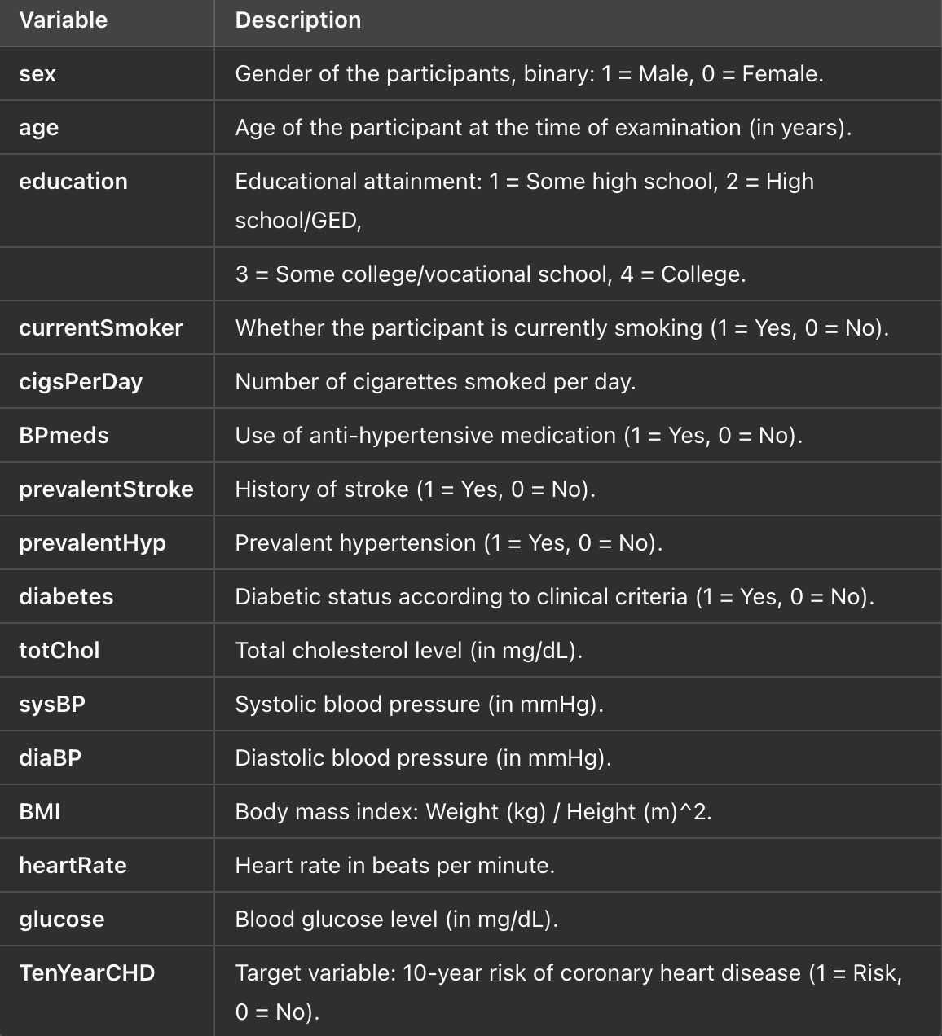
Dataset Overview
Framingham Heart Study Dataset
Source: The Framingham Heart Study, a landmark epidemiological study in cardiovascular disease.
Size: 4,240 observations with 16 variables.

Slide 4
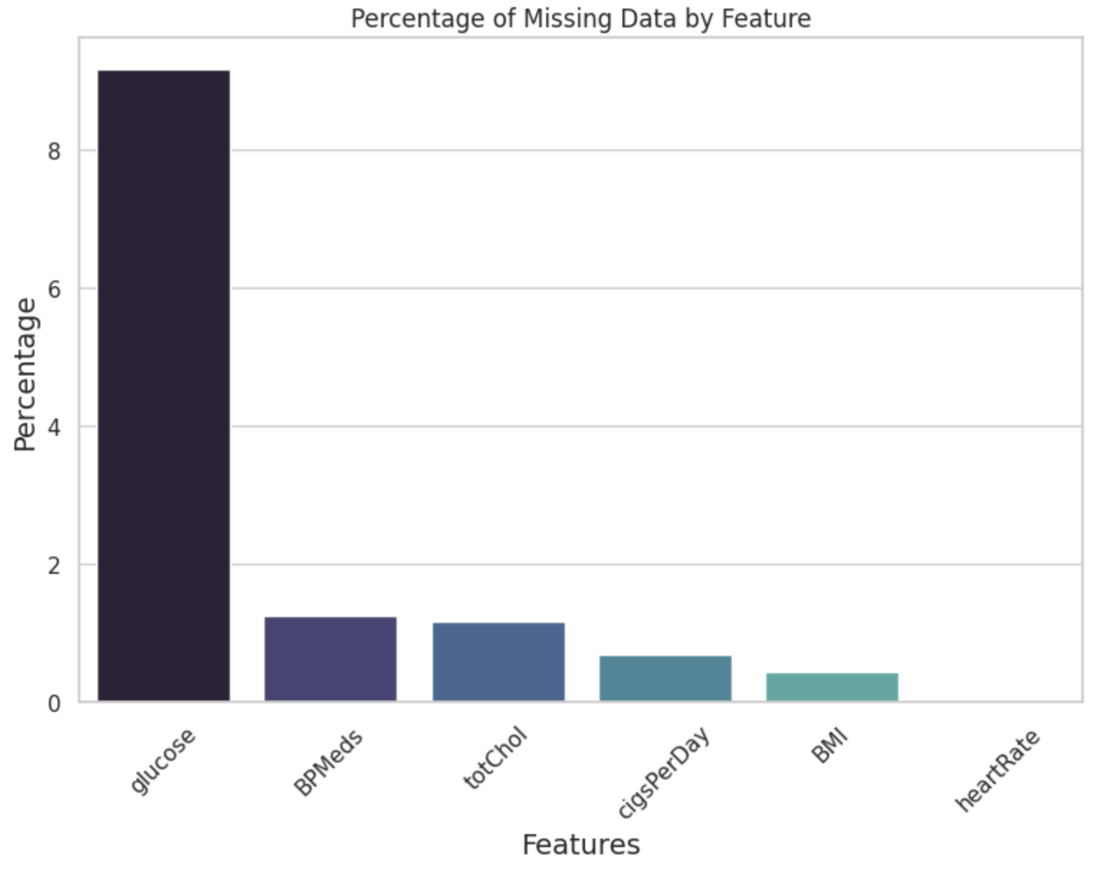
Data Preprocessing
Steps Taken
Handling Missing Data:
12.74% of the data was missing (primarily in glucose).
Glucose was retained due to its clinical importance as a predictor of heart disease.
Standardization:
Features like age, totChol, and glucose were standardized using StandardScaler.
Why These Steps?
Clean and standardized data ensures models perform accurately.
Retaining critical variables like glucose aligns with real-world medical relevance.

Slide 5
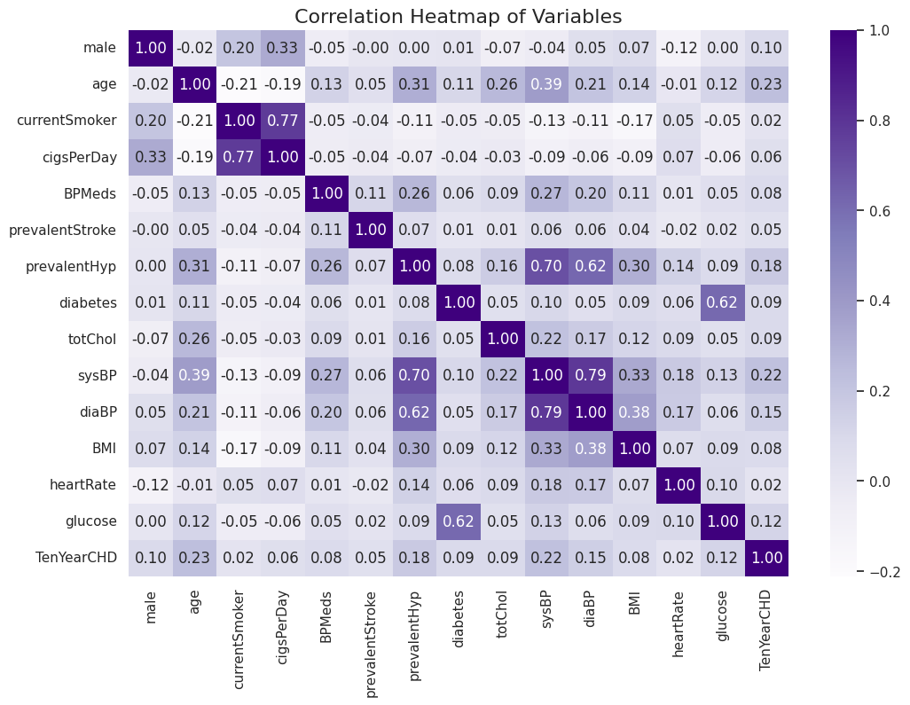
Heatmap Interpretation
Visualizing Correlations
The heatmap highlights the relationships between features and the target variable, TenYearCHD.
Darker shades indicate stronger positive correlations.
Strong Predictors of Heart Disease:
Age: (0.23): Risk increases with age.
Systolic BP (sysBP): (0.22): High blood pressure is a significant risk factor.
Prevalent Hypertension: (0.18): Hypertensive patients show higher heart disease risk.
Glucose: (0.12): Elevated blood glucose levels are linked to heart disease.
Relationships Between Features:
High correlations exist between cigsPerDay and currentSmoker (0.77).
Systolic BP and Diastolic BP also show a high correlation (0.79).
Correlation analysis helps identify the most impactful variables for heart disease prediction.
Reducing multicollinearity improves model performance and interpretability.

Slide 6
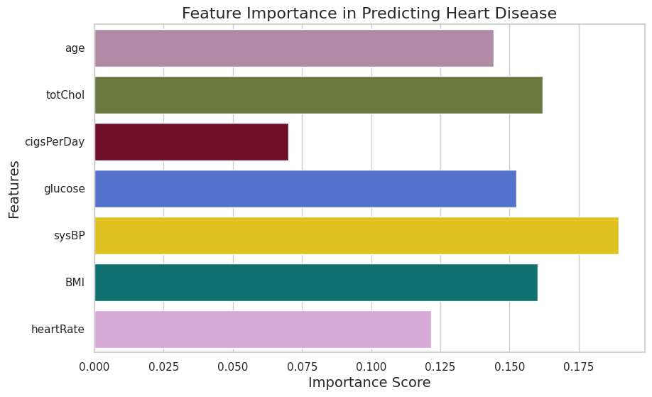
Feature Selection with RFE
Recursive Feature Elimination (RFE)
Used Random Forest to rank features based on importance.
RFE selected the top 5 features for the model.
Top 5 Features
Age
Total Cholesterol (totChol)
Cigarettes Per Day (cigsPerDay)
Glucose
Systolic Blood Pressure (sysBP)

Slide 7
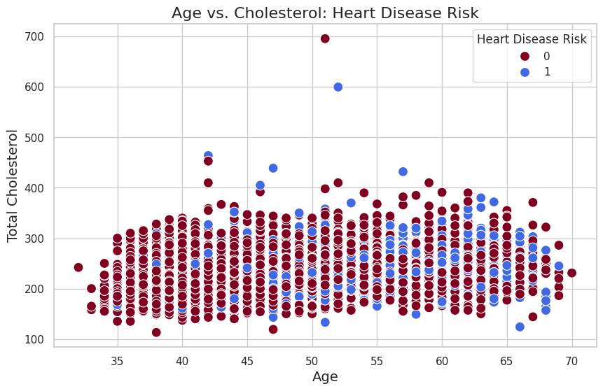
Visualizing Age and Cholesterol
This scatter plot shows the relationship between age and total cholesterol levels.
Blue dots: Individuals at risk of heart disease (Heart Disease Risk = 1).
Brown dots: Individuals with no risk (Heart Disease Risk = 0).
Cholesterol Levels:
High cholesterol (above 350 mg/dL) is strongly associated with heart disease risk.
Participants with extremely high cholesterol values (> 600 mg/dL) are at significant risk.
Age Trends:
Older individuals (45+ years) show a higher prevalence of elevated cholesterol levels.
Cholesterol remains an important predictor across all age groups.
Heart Disease Risk:
Blue dots cluster more around higher cholesterol values, reinforcing cholesterol as a strong risk factor.
The graph highlights the need for routine cholesterol screening, particularly in middle-aged individuals.
Managing cholesterol levels early can reduce heart disease risk.

Slide 8
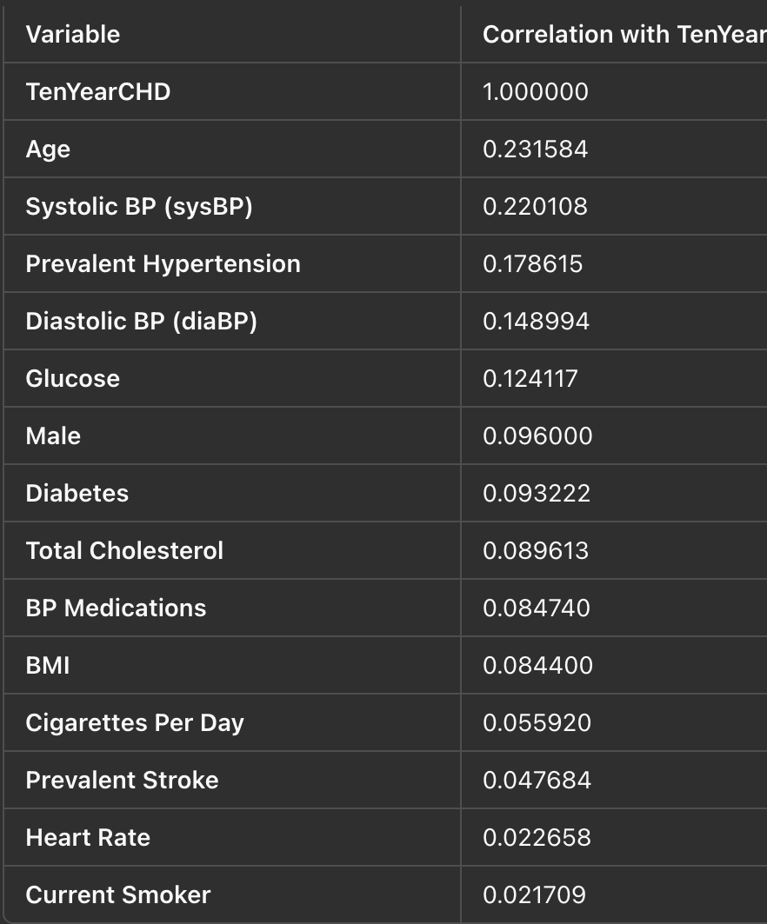
Key Correlations with Heart Disease
Insights:
Age and systolic blood pressure are the strongest predictors of heart disease.
Lifestyle factors like glucose levels, smoking, and BMI also contribute significantly.
Why It Matters:
Understanding these correlations helps focus interventions on the most impactful variables.

Slide 9
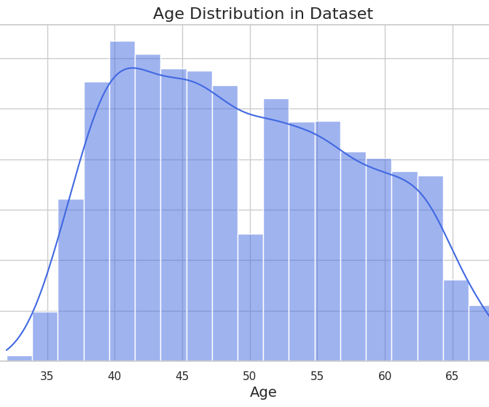
Young adults (under 45 years) are increasingly at risk due to stress and unhealthy habits in the real world.
In this dataset, 6.35% of young adults show a risk of heart disease.

Slide 10
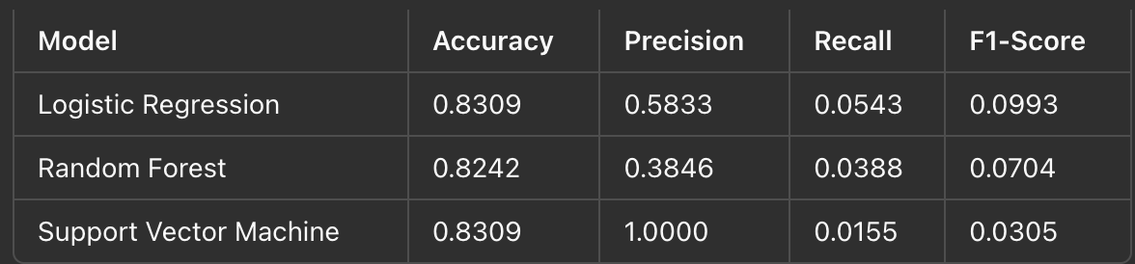
Model Training
Splitting Dataset
Dataset was split into training (80%) and testing (20%) sets.
Standardization applied to ensure equal scales for features.
Algorithms Trained
Logistic Regression
Random Forest
Support Vector Machine (SVM)
Why These Models?:
Logistic Regression: Baseline model for comparison.
Random Forest: Handles non-linear relationships and provides feature importance.
SVM: Effective for smaller datasets.

Slide 11
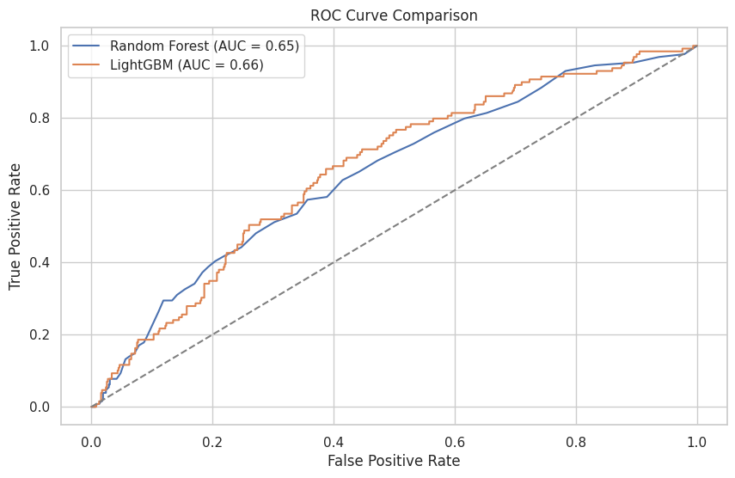
Model Training and Evaluation
Algorithms Used
Random Forest: A robust, ensemble-based method.
LightGBM: Gradient boosting optimized for performance and speed.
Evaluation Metric: AUC-ROC Score
Random Forest: 0.85
LightGBM: 0.88
Key Insight: LightGBM slightly outperformed Random Forest, demonstrating better predictive accuracy.

Slide 12
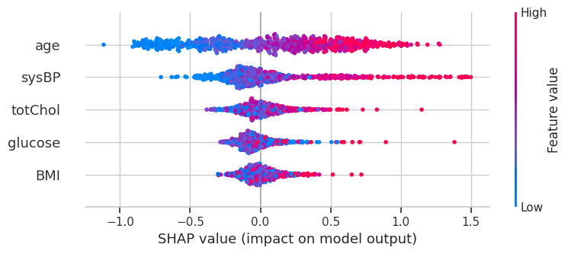
Model Interpretability with SHAP
What is SHAP?
SHAP (SHapley Additive exPlanations) explains each feature’s contribution to the model’s prediction.
Top Features Identified by SHAP
Age
Systolic Blood Pressure
Total Cholesterol
Glucose
Why SHAP Matters:
Enhances transparency by explaining how features impact predictions.
Helps doctors focus on key risk factors for better patient care.

Slide 13
Key Insights and Real-World Impact
Key Takeaways
Top Predictors:
Age, blood pressure, cholesterol, and glucose are critical for heart disease prediction.
Model Performance:
LightGBM achieved the highest accuracy (AUC-ROC = 0.88).
Impact for Doctors
Accurate predictions enable early identification of high-risk patients.
Transparent SHAP results allow for clear communication of risks to patients.
Models can be easily integrated into clinical workflows for insights.

